Slide 1
Using Ag Data to Know What is Happening in Your State
Jessica Castañeda
Educational Consultant-Spark Innovations

Slide 2
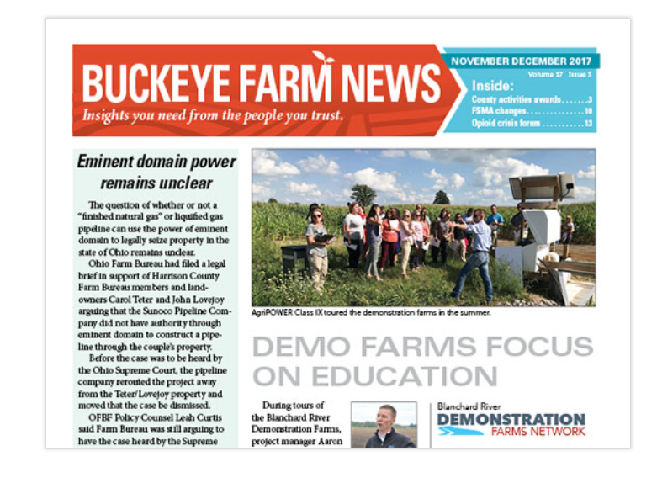
Find the Directories for your state
What is your state well known for?
Do they have associations or programs for farmers that you should partner with?
Do you have good ties with all Agriculture Associations in your state?
https://togetherwithfarmers.org/

Slide 3
Food Directory listings
https://www.ams.usda.gov/services/local-regional/food-directories-listings
Local food directory- farms- https://www.ams.usda.gov/local-food-directories/onfarm

Slide 4
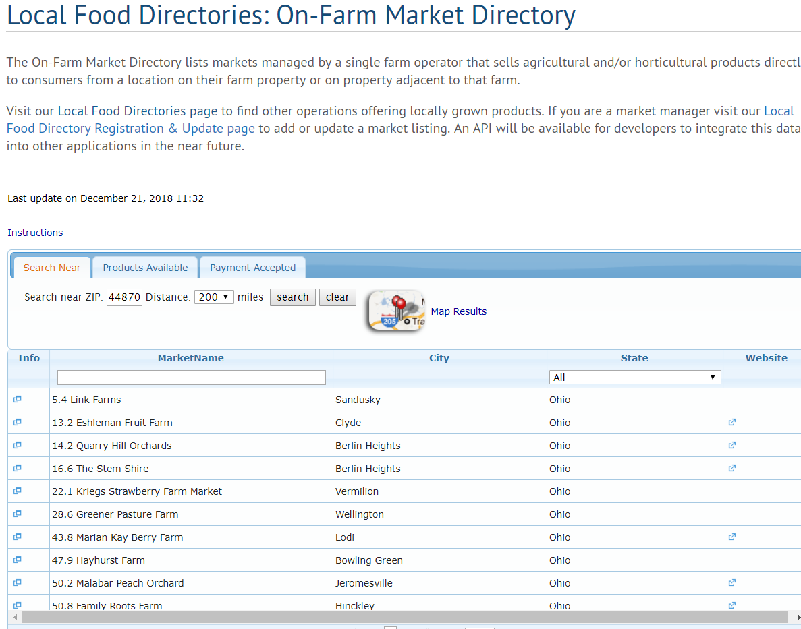
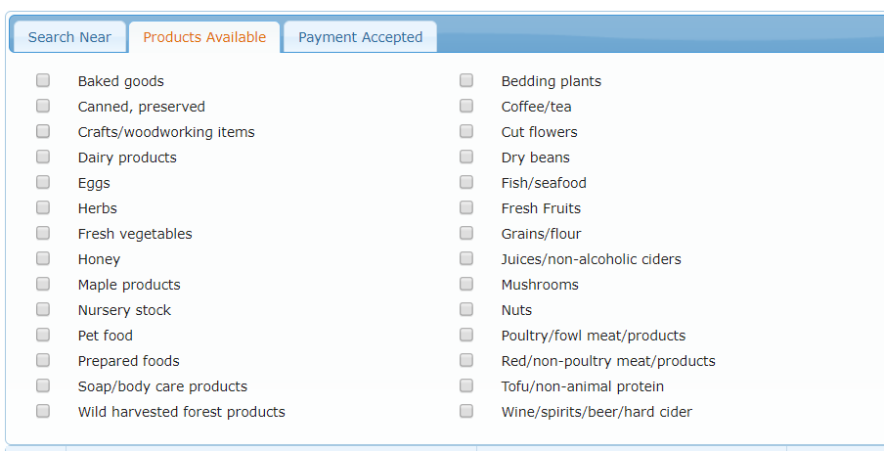
Food Directory listings
Local food directory- farms- https://www.ams.usda.gov/local-food-directories/onfarm

Slide 5
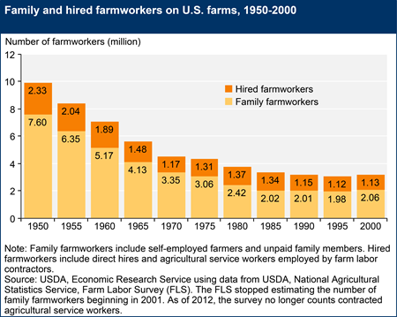
USDA Resources- THERE ARE TONS!!!!
Farm Labor Information
https://www.ers.usda.gov/topics/farm-economy/farm-labor/#links

Slide 6
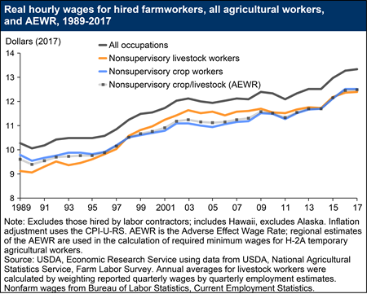
USDA Resources- THERE ARE TONS!!!!
Farm Labor Information
https://www.ers.usda.gov/topics/farm-economy/farm-labor/#links

Slide 7
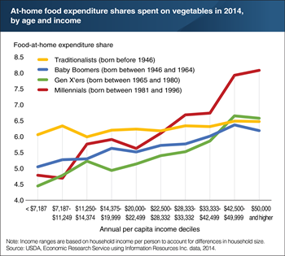
USDA is a place to visit often
https://www.ers.usda.gov/topics/
Tons of Topics
Farm Economy
Animal Products
Crop Outlooks
Food Markets
International Trade
Rural Population
https://www.ers.usda.gov/data-products/editors-pick-charts-of-note-2018/

Slide 8
USDA Atlas Maps
https://www.ers.usda.gov/data-products/food-environment-atlas/go-to-the-atlas/

Slide 9
Ag Census Web Maps
https://www.agcensus.usda.gov/Publications/2012/Online_Resources/Ag_Census_Web_Maps/index.php

Slide 10
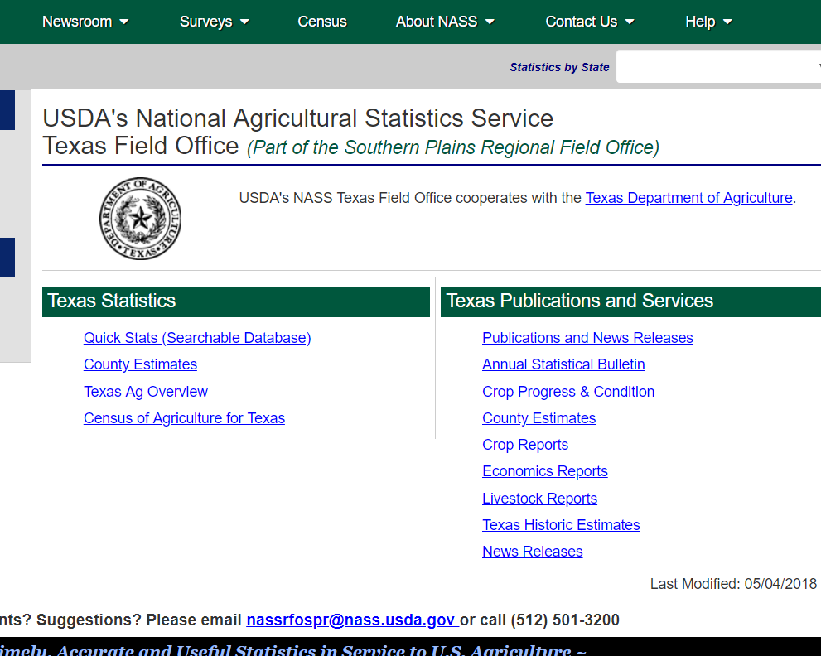
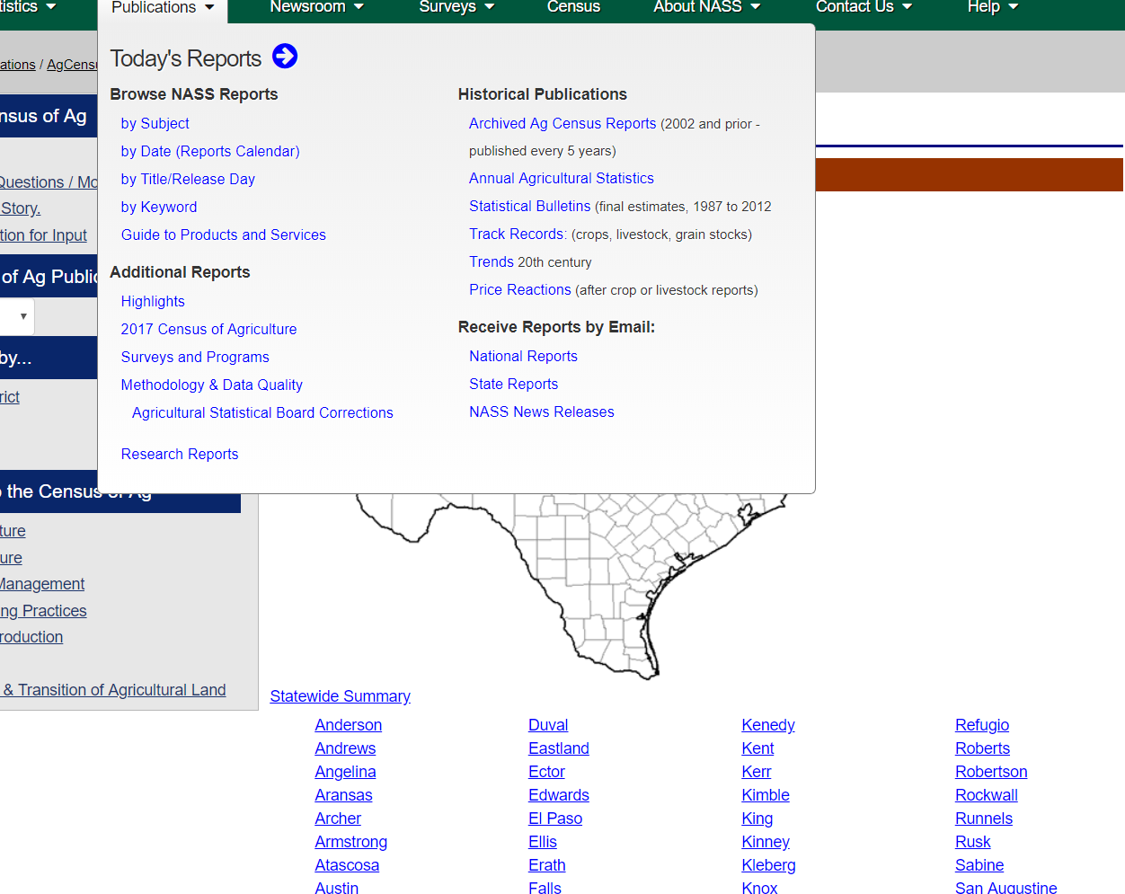
Ag Census Summary
https://www.nass.usda.gov/Statistics_by_State/Texas/index.php
https://www.nass.usda.gov/Publications/AgCensus/2017/Online_Resources/County_Profiles/Texas/

Slide 11
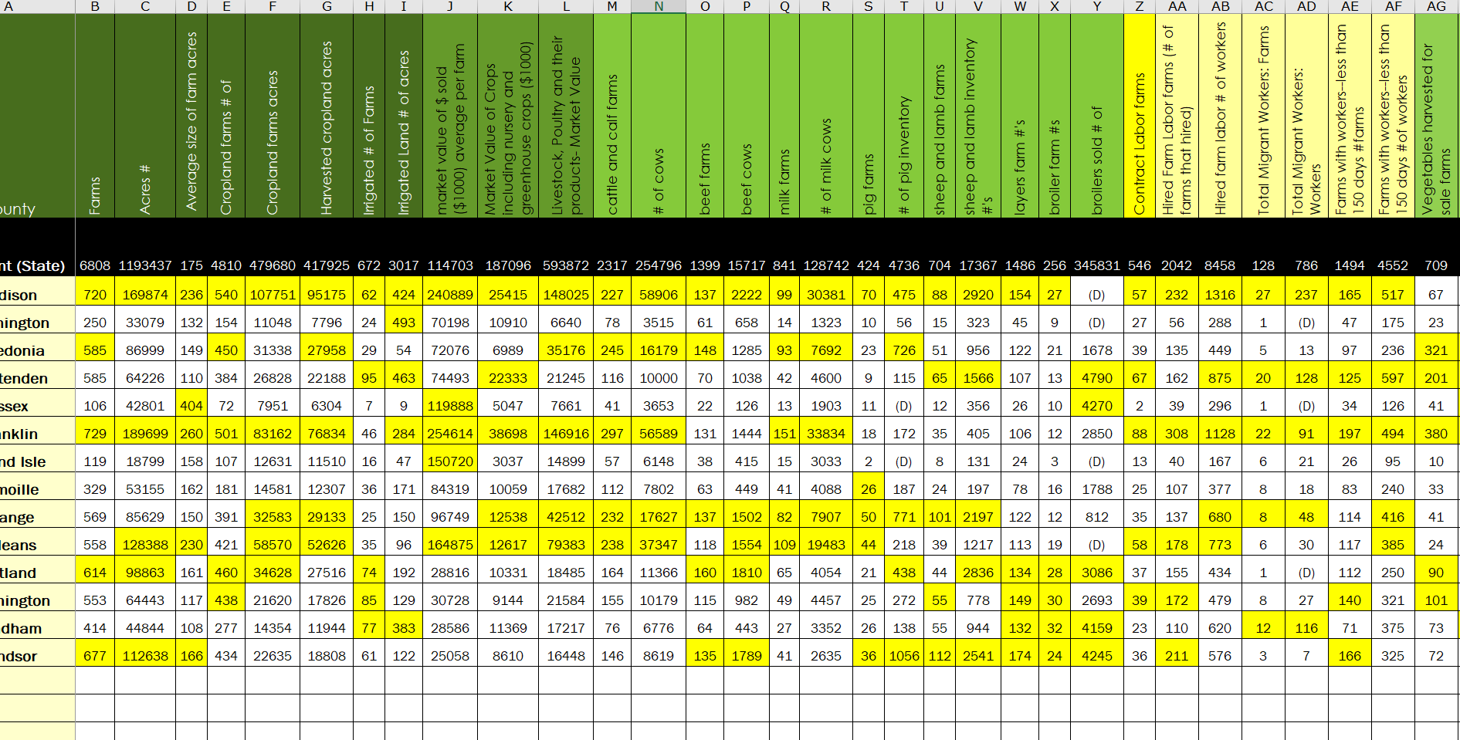
Ag Census
Make Spreadsheet to use with Power BI

Slide 12
H2A Farm Listings

Slide 13
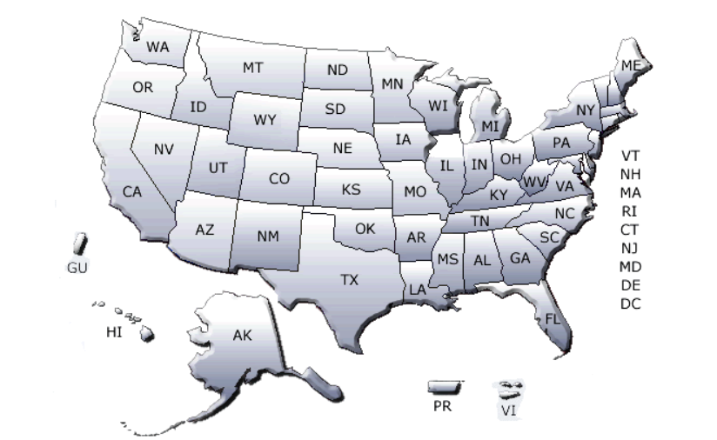
H2a in VT
https://www.foreignlaborcert.doleta.gov/map/2016/VT.pdf

Slide 14
Projected H2A 2017 reports

Slide 15
Icert Portal
Use this to keep up with new listings of H2A farms and the details of where workers will live, work and what they will be doing.
The numbers of H2a workers keep rising all over.

Slide 16
Crop Scape- Cropland Data Layer- USDA
View specific places and what crops are available by address
View summary reports of what a county or a region has.
View changes from one year to another in land use
Identify crops at the pixel

Slide 17
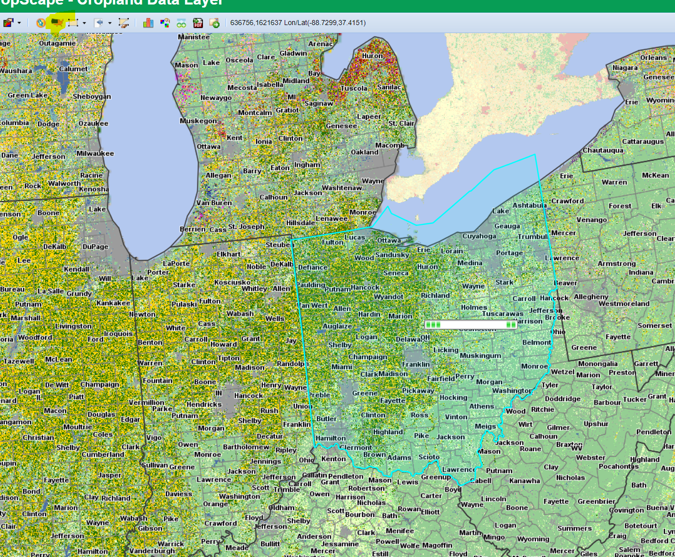
Define an Area of Interest

Slide 18
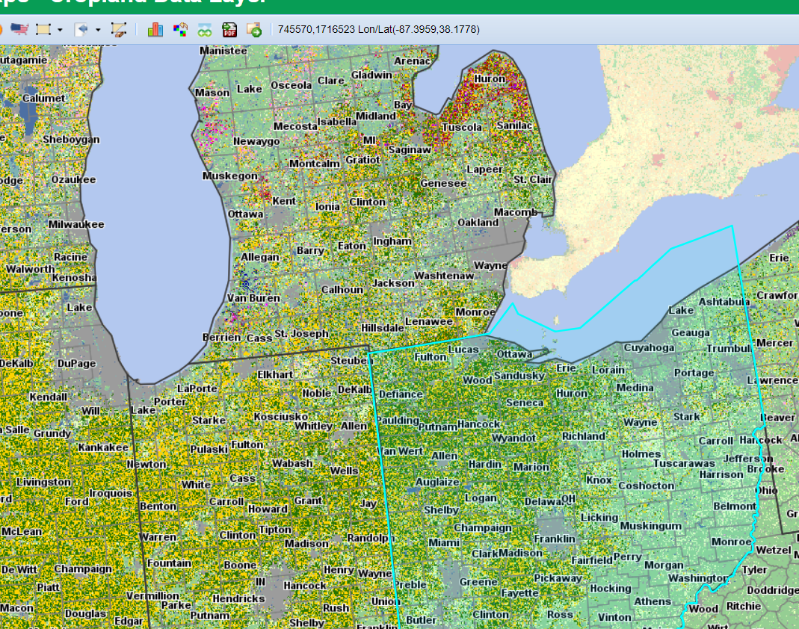
Then Get Statistics on that Area

Slide 19
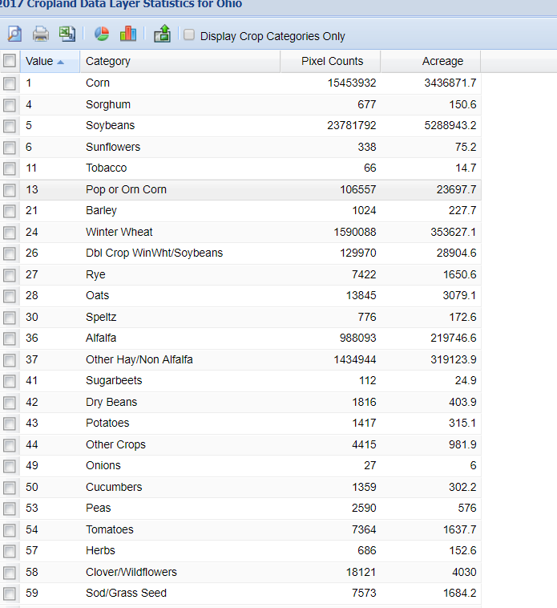
Then Get Statistics on that Area

Slide 20
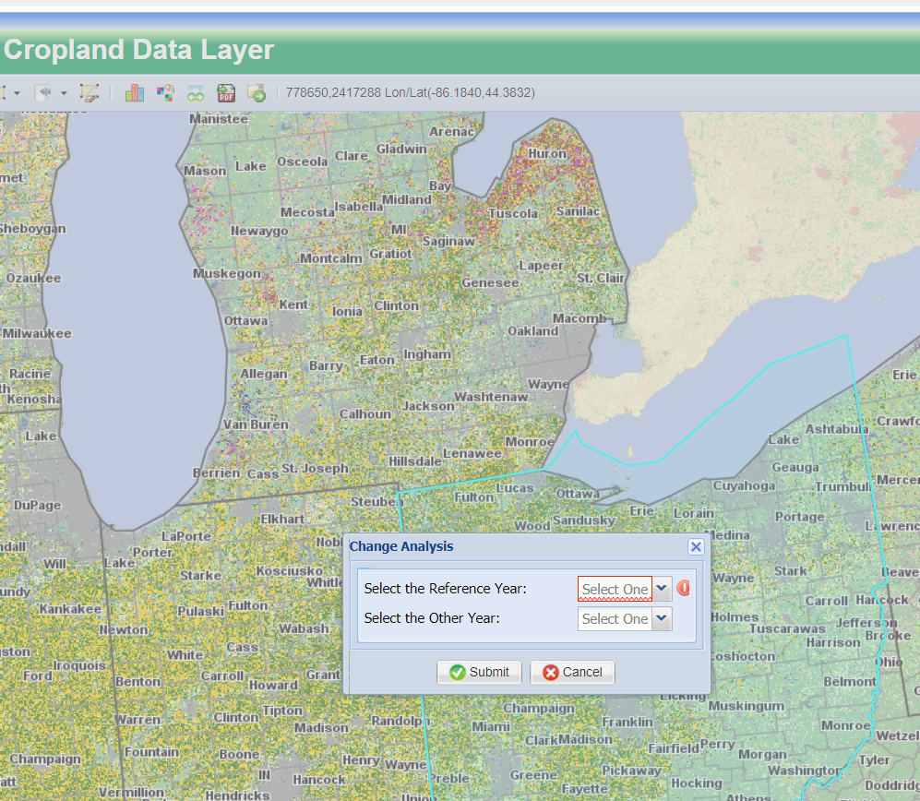
Then look at Comparison Data

Slide 21
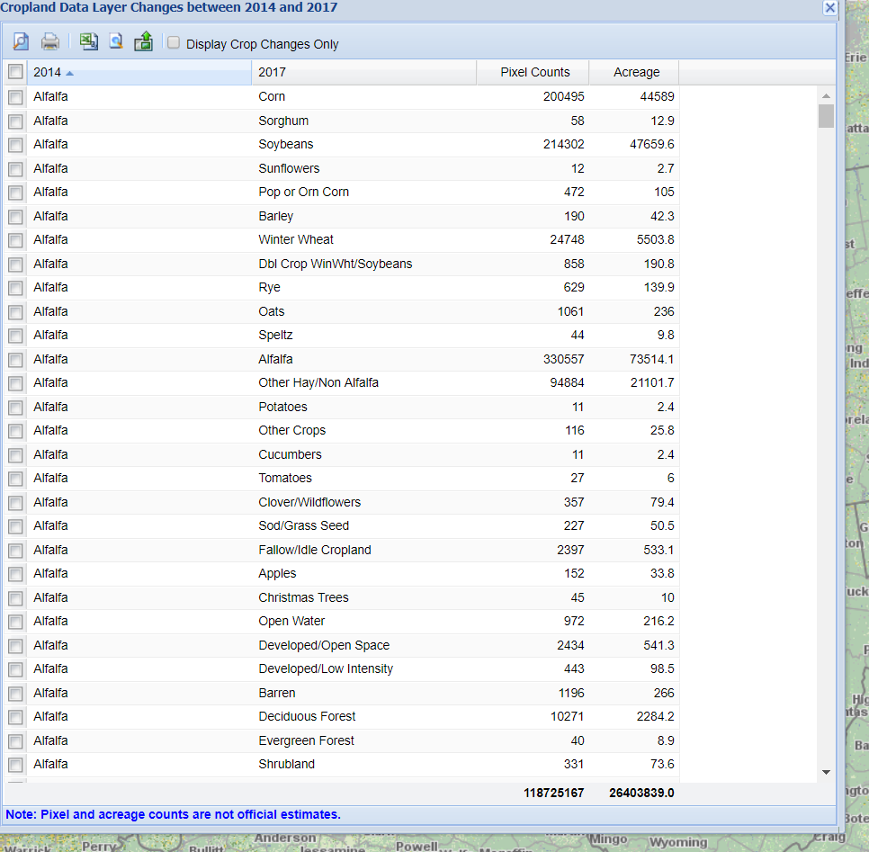
Then look at Comparison Data See how what was Alfalfa is now other things

Slide 22
Make sure to play around on CroPScape there is plenty to learn!

Slide 23
Farm Subsidy Database
Identify names of farmers who have received subsidies
Learn how they have changed
Search by state
See state statistics by crop area
Find your Biggest Farmers!

Slide 24
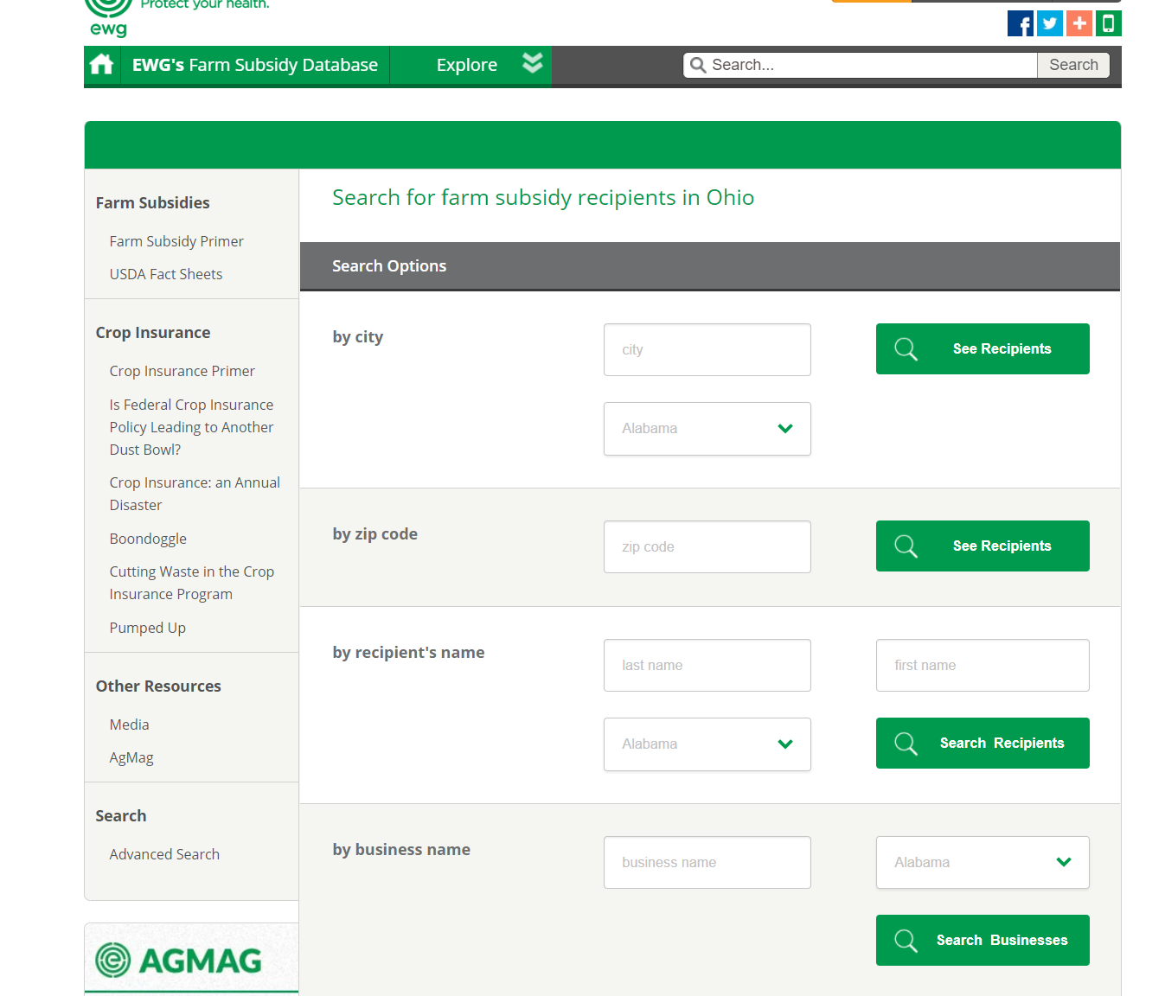
Farm Subsidy Database

Slide 25
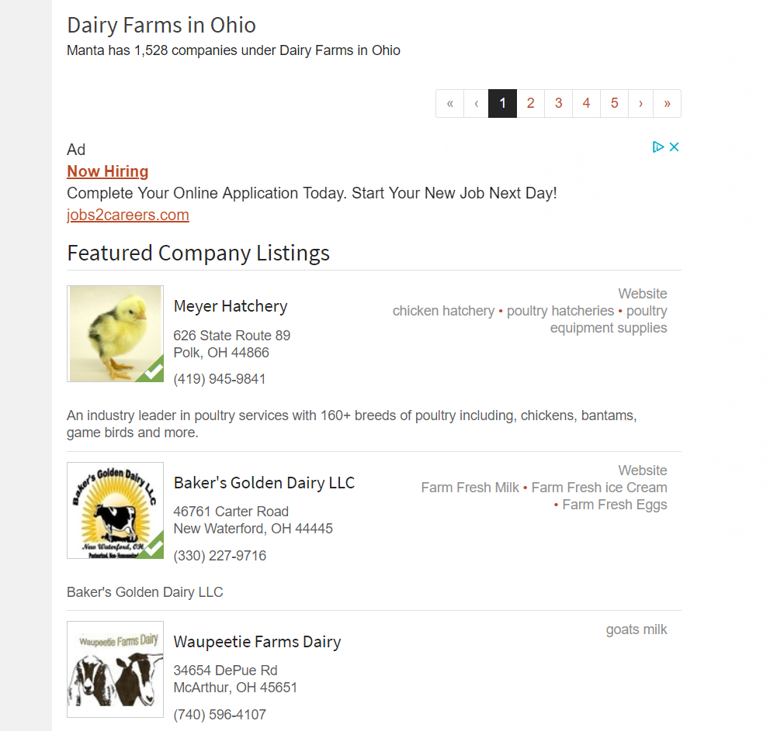
MANTA- Business white pages

Slide 26
Google Maps
Use them to log in key farms
Keep data of visits on private maps
Use them as GPS out in the field to stay organized
Helpful when organizing recruiting efforts and sweeps
https://drive.google.com/open?id=1CUcFOPoUSC1R03O1vixWFPeAoUo&usp=sharing

Slide 27
Using Google Earth to view areas

Slide 28
Using Google to search about ag in your state
Don’t forget the power of a good search
If things are changing most likely there is an explanation in a local news report.
Worker numbers are changing nationwide. View the IRRC lit review to learn more.
View Powerpoint
Colorado- workers
LA- ag update

Slide 29
Google NEWs Alerts
https://support.google.com/websearch/answer/4815696?hl=en

Slide 30
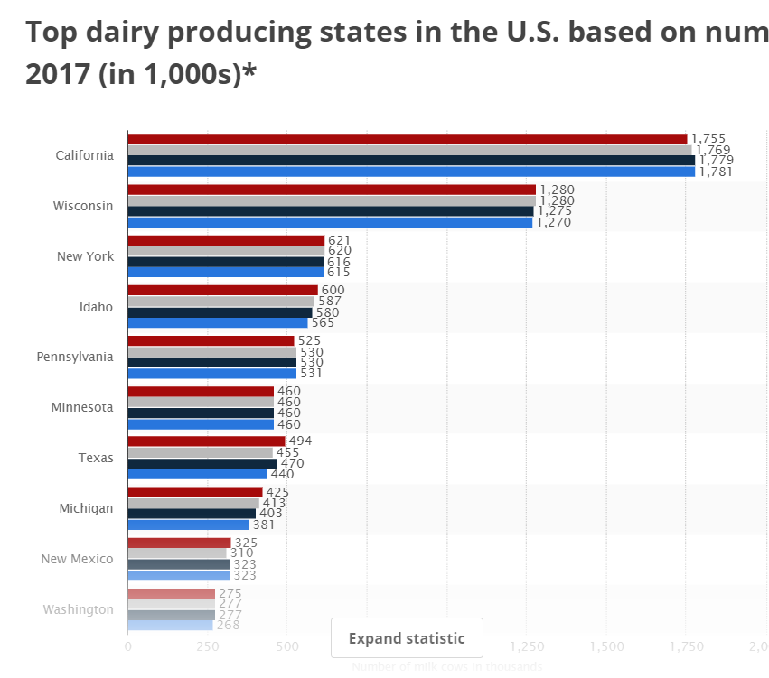
IRRC Ag Trends Resources- Dairy
http://www.idr-consortium.net/DairyTrends.html

Slide 31
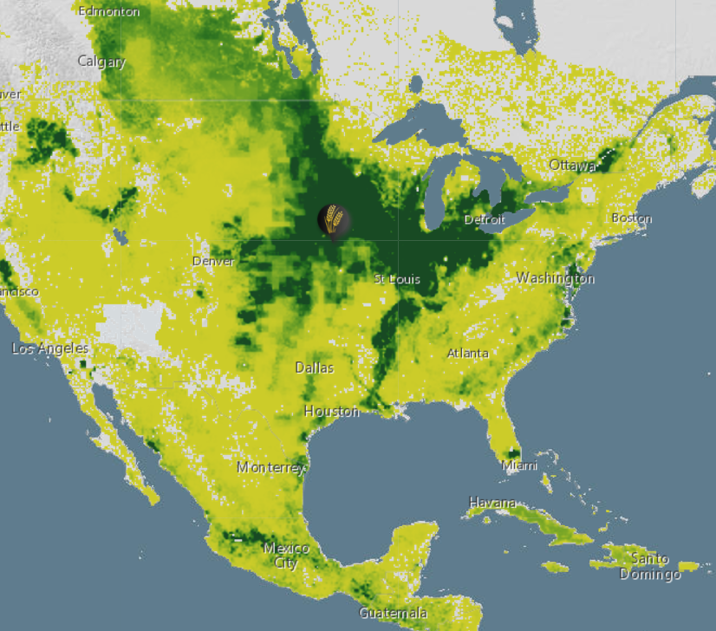
IRRC Ag Trends Resources- Petroleum and Water

Slide 32
IRRC Ag Trends- New Technologies

Slide 33
IRRC- State Profiles

Slide 34
Farm Plenty Local Crop Trends
Review top crops in a localized area.
View how the prices of the crops have grown and the percentage of the acres in an area.

Slide 35
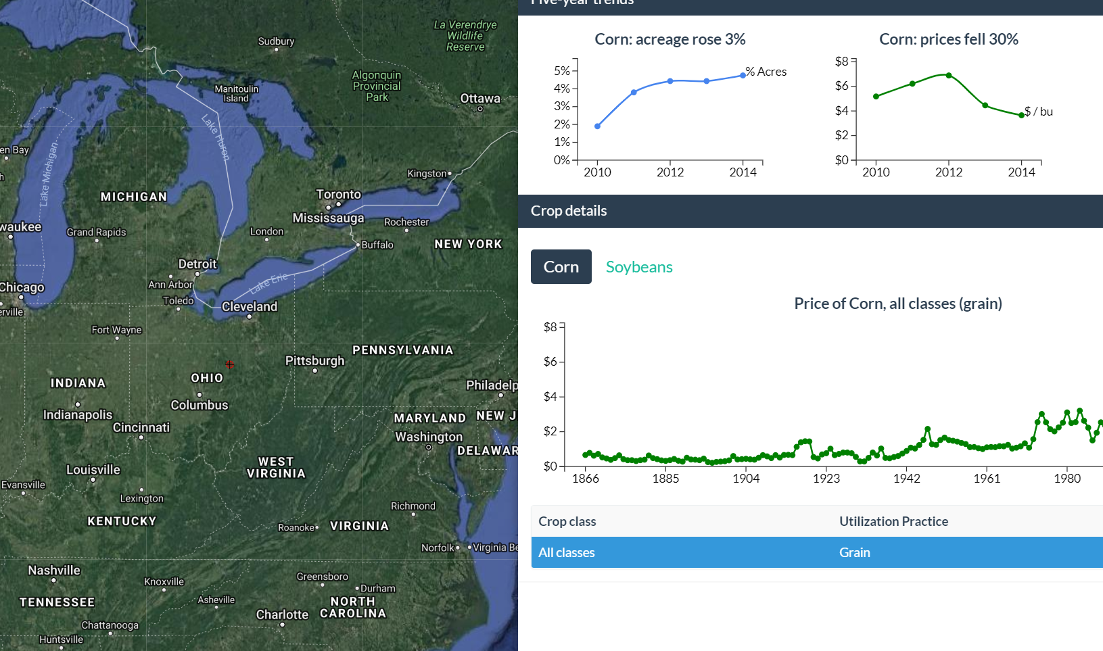

Slide 36
Contact Information

